Slide 1
How is pollution in the US affected by diverse factors?
Ana Sofía Galán
Jose Marcos Marmolejo
Juan Eduardo Delgado
Alfredo Velarde

Slide 2
Hypothesis
Factors such as population, motor vehicles, industrial activity and wildfires affect pollution levels in the US. We believe that the main air pollutants (NO2, O3, SO2, CO) will increase as the levels of these factors grow in a certain State.
How is pollution measured?
Which are the main pollutants? How are they measured?
Is there available information for all the factor that we are considering? Is it reliable?
How should we compare our information (yearly/monthly, by city/state/county, etc.)?

Slide 3
Sources of Information
Pollution
CSV extracted from Kaggle with data scraped from the database of U.S. EPA with four major pollutants (Nitrogen Dioxide, Sulphur Dioxide, Carbon Monoxide and Ozone) for every day from 2000 to 2016.
Wildfires
SQLite database extracted from Kaggle of Forest Service Research Data Archive with information on wildfires that occurred in the United States from 1992 to 2015.
Population
CSV extracted from US Census with information and estimates by City / State on US population from 2010 to 2018.
Industry
Public databases.
Note: Information on motor vehicles and industrial activity didn’t fit the requirements for the analysis.
Sites:
Pollution: https://www.kaggle.com/sogun3/uspollution
Population: https://www.census.gov/content/census/en/data/tables/time-series/demo/popest/2010s-total-cities-and-towns.html#ds
Wildfires: https://www.kaggle.com/rtatman/188-million-us-wildfires

Slide 4
Data Cleanup & Exploration
first
second
last
We take pollution information as the axis for the analysis. Looking to find a link between fires and the population as pollutants increase.
By reviewing the data we identified missing information, we decided to focus on the 4 main air pollutants: NO2, O3, SO2, CO
In order to merge the other variables: wildfires and population, we analyzed under which criteria this could be completed: years and states.
Information on motor vehicles and industrial activity didn’t fit the requirements for the analysis: Vehicles was not available divided by state; and Industrial activity was too detailed and filtering it out would have taken a lot of effort.

Slide 5
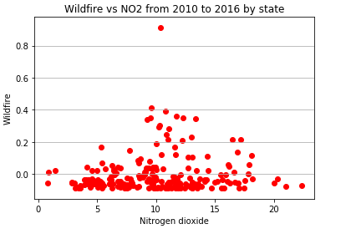
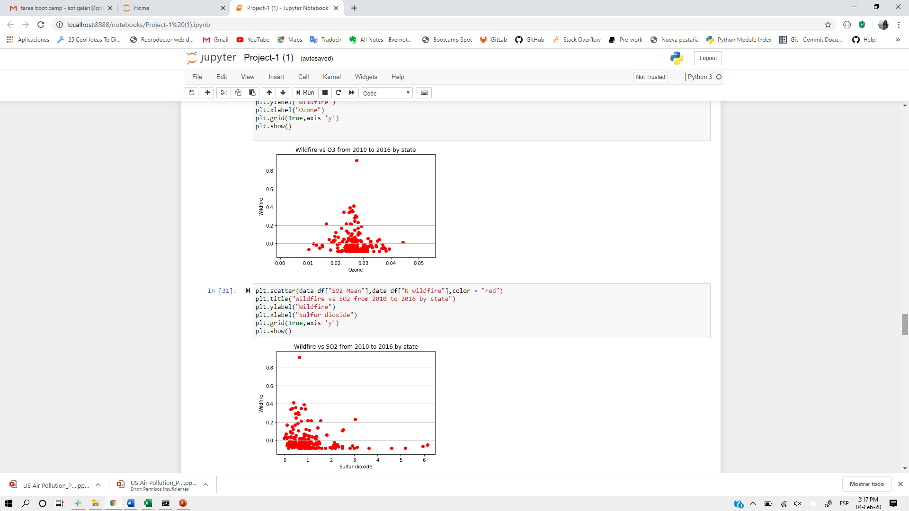
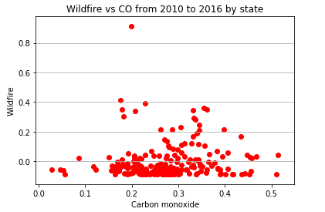
Data Analysis
Our analysis aimed to compare how the level of population and occurrences of wildfires relate to the levels of the four main air pollutants, in a given US state, each year from 2010 to 2016.
We started by comparing Wildfires vs. 4 types of air pollutants.
However, graphically, all plots showed almost no linear correlation between our variables.

Slide 6
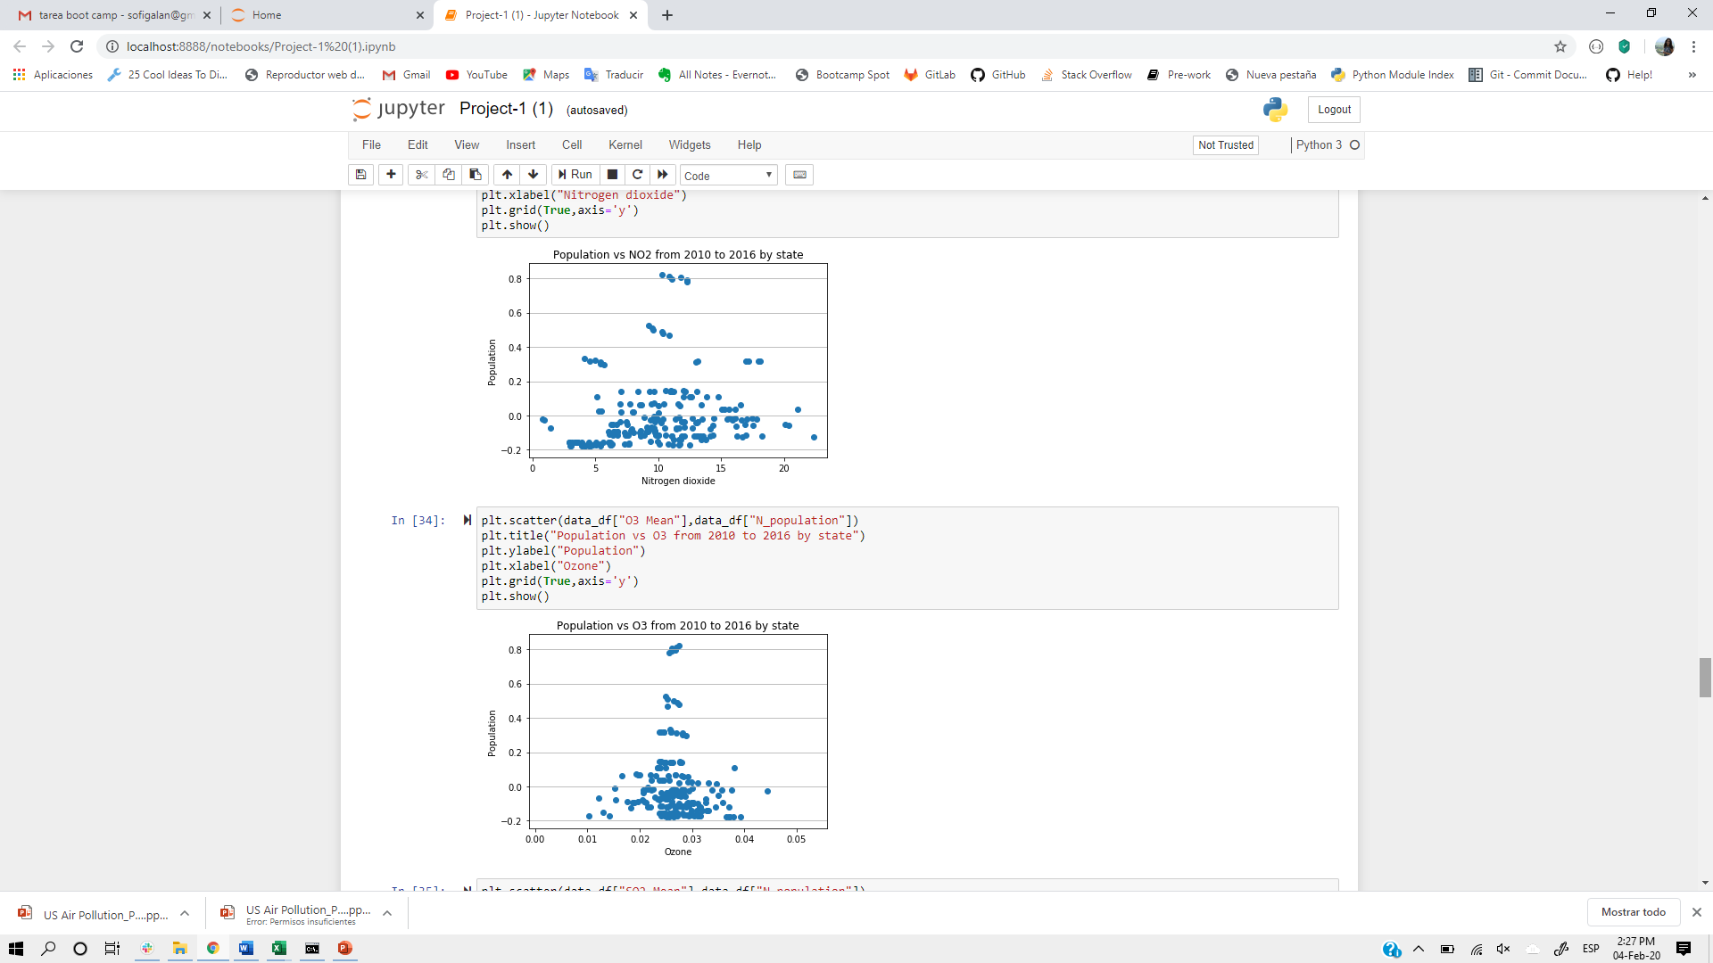
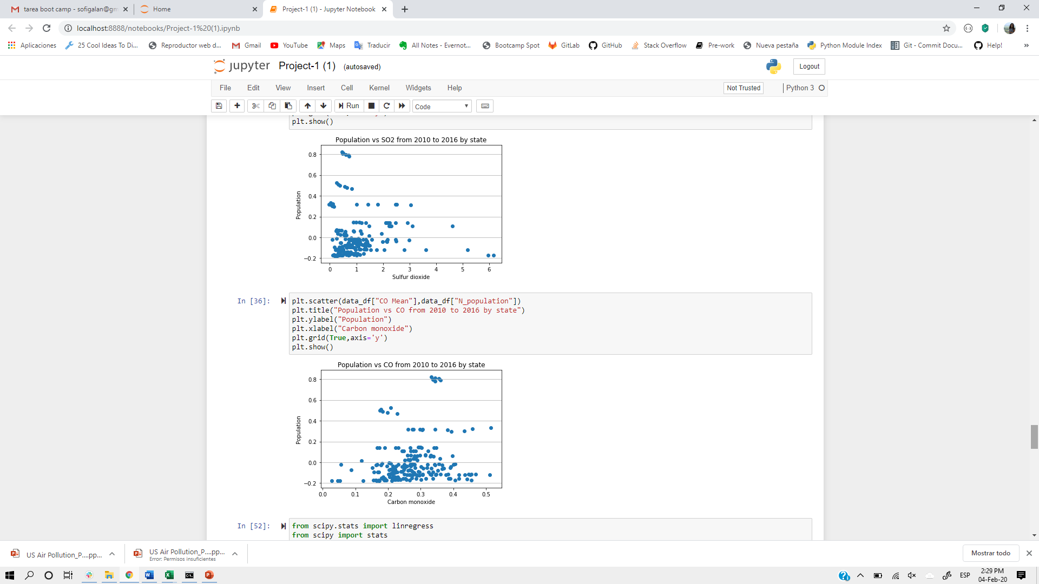
Data Analysis cont.
The same behavior can be observed when comparing population vs. air pollutants.

Slide 7
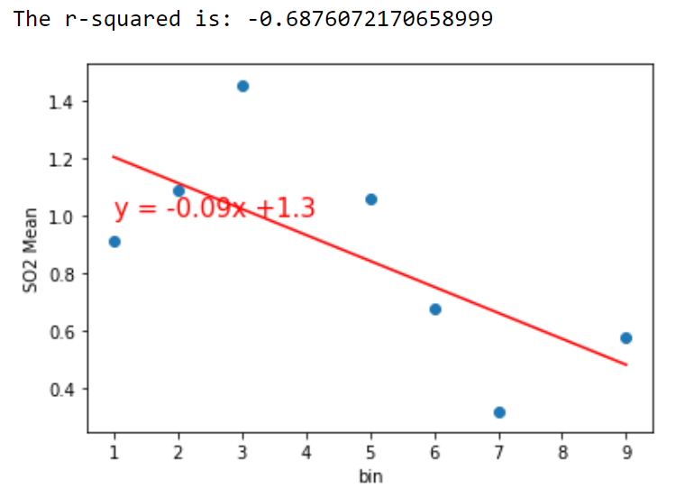
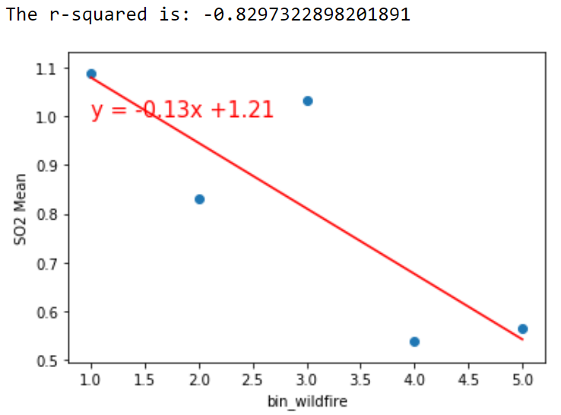
The information on population and wildfire variables was then divided into bins to normalize the information. We then made scatter plots and concluded that the only pollutant with a significant correlation to our two variables was SO2 (Sulfur dioxide).
Population
Wildfires

Slide 8
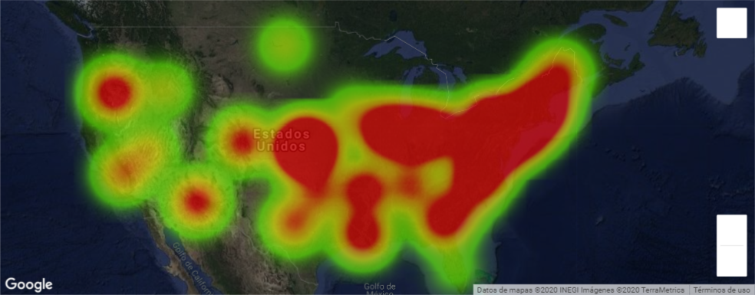
US concentration of SO2 in 2010

Slide 9
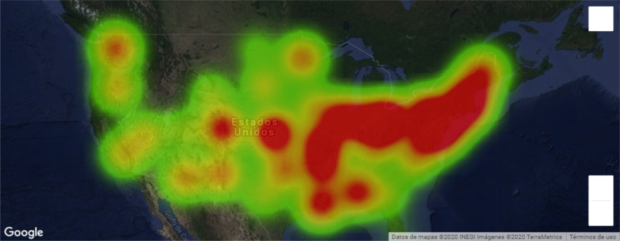
Decrease in
SO2
concentration
US concentration of SO2 in 2015

Slide 10
Conclusions
Other factors need to be taken in consideration, such as: latitude, proximity to the sea or growth in economy.
There’s no linear correlation between wildfires, population and air pollutants.
The US has been reducing the emission of air pollutants over the past years; this with help of policies such as Clean Air Act.

Slide 11
Thanks!
Any questions ?

